Slide 1
Congress on Intelligent Systems (CIS-2020) 16,17- OCTOBER’2020 Paper ID : IFERP(AI_MI)_051046285 Stress Classification of Medical Practitioners Using Machine Learning Techniques
Maggi Monika Wilson, Dr. Chandra J, Dr. Vinnarasi B
Department of Computer Science,
CHRIST (Deemed to be University),
Bangalore, Karnataka, India

Slide 2
Agenda
1. Introduction
2. Related Works
3. Scope and Research Gap
4. Social impact
5. Methods and Materials Used
6. Proposed framework
7. Result and Discussion
8. Conclusion
9. References
1

Slide 3
INTRODUCTION
In this era , most of the people consult the experts for seeking help to rescue them from the stress feeling. The stress is formed from the over-working status.
Stress is a feeling of mental depression and tension. Low levels of stress might be desired , useful, and even healthy.
Stress, in its positive form, can improve biopsychosocial health and facilitate performance.
Consequences of work stress can be categorized as Cognitive Consequences(mental illness, concentration problem etc), Behavioural Consequences(sleeping disorder, use of drugs and alcohols etc),Emotional Consequences(short temper, impatient, depression etc) and Physical consequences(back and neck pains, heart problems, blood pressure etc).

Slide 4
Stress in doctors can be caused by numerous factors ranging from excessive workload and extended work hours to complicated cases and demanding superiors, in addition to a family life that has to be attended to as well .
The emotions doctors feel while caring for seriously ill patients affect both the doctors’ practices and their well-being, especially if they fail to examine these feelings.
Doctors those who feel stressed , seek help by having drugs, alcohols and many other ill-practices. Some of them try to treat themselves instead of consulting other doctors .

Slide 5
Related Works
Detection and Analysis of Stress using Machine Learning Techniques Reshma Radheshamjee Baheti, Supriya Kinariwala.
Journel: International Journal of Engineering and Advanced Technology (IJEAT) ISSN: 2249 – 8958, Volume-9 Issue-1, October 2019
Reshma Radheshamjee et. al., has proposed detection and analysis of stress using machine learning techniques. The main aim proposed by the researchers was to detect the stress using the information from the social media networking sites(emotions) , like twitter.
Here TensiStrength framework is used to detect the strength of stress and relaxation expressed in social media text messages. The framework used lexical approach to detect direct and indirect expressions.
Findings: who works longer period, sometimes the doctors are not claiming their compensation. This is mostly seen in women doctors who are forced to do work in a corporate sector, meanwhile the major percentage from the male doctors they have claimed their compensation.
The study indicates the management Occupational Stress is needed as a countermeasure against depression among doctors .
5

Slide 6
Nareem Mansoor et.al., has analyzed the level of stress among doctors in public and private hospitals of Pakistan
Journel: International Journal of Learning & Development ISSN 2164-4063 2013, Vol. 3, No. 2
Nareem Mansoor and et al., has analysed the level of stress among doctors in public and private hospitals of Pakistan. The authors proposed the study because to find out the sources of stress mong the doctors in both the sectors. The study was analysed with the help of questionnaire section.
The questionnaire took based on the seven aspects ie, Workload, working condition, role overload, sleep deprivation and unrealistic demands of the patients.
The statistical tool is used to measure the priorities that seven aspects falls. The first source of stress was identified with the sleep deprivation, second was workload, third was working condition, fourth was role overload and the last was the unrealistic demands of the patient.
The authors showcased the comparative study on private and public that, in public sector the doctors are mostly affected with the stress than the private sector doctors.
6

Slide 7
Methodology
The outline of the stress classification using machine learning techniques is to classify the data into two classes whether stressed or not using KNN, CNN, SVM, Decision Tree and Random Forest.
Through genomics we can identify which gene variation has caused the cancer, detect which kind of cancer and also predict the stage accurately, so that the doctors can plan the treatment accordingly.
Only implementing using genomics will take lot of time.
The main idea is to integrate machine learning and genomics so that we can improvise the time and reduce the cost.
Machine learning is used in the genomics to do effective analysis at the early stage and also to reduce the burden of the patients as well as doctors.
12

Slide 8
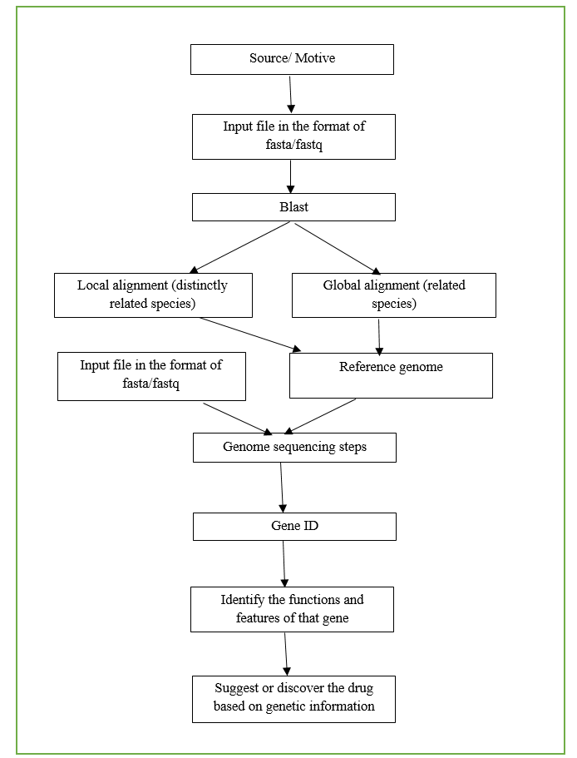
Proposed Framework
13

Slide 9
Dataset Description
The Alumina of NIMHANS College provides the data through questionnaire method.
Around 10 attributes were analysed to predict the presence of stress in them.
14

Slide 10
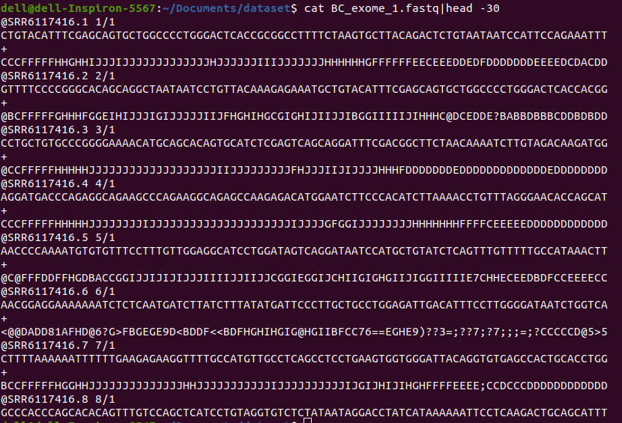
Dataset Preview
15

Slide 11
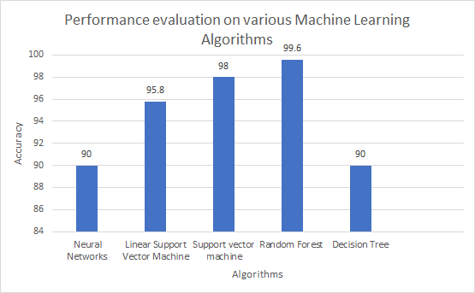
Result and Discussion
Sl no | Technologies Used | Dataset | Accuracy | Outcome of the Research
1 | Neural Networks | Gene expression data from the Cancer Genome Atlas(TCGA) Database | 90% | The outcome of the Neural Networks classifier accuracy is compared with other algorithms.
2 | Decision Tree | Gene expression data from the Cancer Genome Atlas(TCGA) Database | 90% | The outcome of the Decision Tree was measured and compared with other algorithms.
3 | Linear Support Vector Machine | RNA Sequencing Data | 95.8% | Linear Support Vector Machine gave the best results for Classifying RNA-sequencing data and predicting the type of cancer.
5 | Support vector machine | Image data from the Cancer Genome Atlas (TCGA) | 98% | The accuracy of the classification was measured using a support vector machine.The outcome showed the accuracy of 98.9%.
6 | Random Forest | Image data from the Cancer Genome Atlas (TCGA) | 99.6% | The accuracy of the classification was measured using a Random Forest .The outcome showed the accuracy of 99.6%
16

Slide 12
Conclusion
Applying machine learning techniques in Cancer Genome stage Classification will reduce the time taken for treatment and make the process becomes more efficient for a cancer patient.
The study of the genome analysis using machine learning can support precision medicine for effective treatment, as well as the doctors can plan for appropriate treatment for the individual based on the genetic information.
The modifications in the gene expression can help the researchers and doctors to gain more knowledge regarding the understanding of the gene structure. So the integration of machine learning techniques and Genome analysis will improve the treatment for any deadly disease like Cancer and Covid-19.
17

Slide 13
References
WHO, 2018, “Latest global cancer data”, https://www.who.int/cancer/PRGlobocanFinal.pdf.
ICMR,NICPR, June 4, 2020,”Cancer Statistics”,http://cancerindia.org.in/cancer-statistics/.
W. H. Freeman, 2000, NBK21783, “An Introduction to Genetic Analysis”, https://www.ncbi.nlm.nih.gov/books/NBK21783/.
NIH, November 7, 2019 “A brief guide to genomics”, https://www.genome.gov/about-genomics/fact-sheets/A-Brief-Guide-to-Genomics.
Anthony J.F. Griffiths, Nov 13, 2018, “Genomics”, https://www.britannica.com/science/genomics.
Kelley Harris, Nature Genetics 51, 1306-1307, https://www.nature.com/subjects/genomic-analysis.
Machine learning, 7 March 2017, “What is Machine learning? A definition”, https://expertsystem.com/machine-learning-definition/.
Alex Philippidis, August 30, 2018, “10 Countries in 100K Genome Club”,https://www.clinicalomics.com/topics/translationalresearch/biomarkers-topic/biobanking/10-countries-in-100k-genome-club/.
J. Sheng, F. Li and S. T. C. Wong, "Optimal Drug Prediction from Personal Genomics Profiles," in IEEE Journal of Biomedical and Health Informatics, vol. 19, no. 4, pp. 1264-1270, July 2015.
Y. Zhang et al., "Toward precision breast cancer survival prediction utilizing combined whole genome-wide expression and somatic mutation analysis," 2017 IEEE International Conference on Bioinformatics and Biomedicine (BIBM), Kansas City, MO, 2017, pp. 830-835.
18

Slide 14
Thank You
19

Slide 15
Any Questions ?
20

